Slide 2
NAWLA Webinar Series – Webinar #1: Exhibitor Service Kit Launch
Hosted by: Kelsey Kwasniak and Kendall Reynolds

Slide 3
AGENDA
Key Show Details
Dates/location
Show Hours
Key Contacts
Registration/Housing
Security Tips
Booth Package
Shipping Details
Important Deadlines
Accessing Exhibitor Service Kit

Slide 4
KEY SHOW DETAILS
Wednesday, November 13th – Friday, November 15th 2024
Phoenix Convention Center
100 N 3rd St, Phoenix, AZ 85004
Halls 1-3, West Building – same as 2022
Link to schedule of events here.
General Service Contractor - Freeman
Phone: 888-508-5054
Email: exhibitorsupport@freemanco.com

Slide 5
SHOW SCHEDULE
Exhibitor Move In
Tuesday, November 12, 2024
7:00 AM – 11:00 AM
Wednesday, November 13, 2024
11:00 AM – 5:00 PM
Exhibit Hall Hours
Thursday, November 14, 2024
1:30 PM – 6:00 PM
Friday, November 15, 2024
8:00 AM – 12:00 PM
Exhibitor Move Out
Friday, November 15, 2024
12:00 PM – 6:00 PM
All exhibitors must be moved out no later than 6:00 PM on Friday, November 15.

Slide 6
KEY SERVICE CONTACTS
Show Management
Kendall Reynolds
Kelsey Kwasniak
Exhibits@nawla.org
General Service Contractor
Freeman
Phone: 888-508-5054
Email: exhibitorsupport@freemanco.com
Rigging
Audio/Visual
Prestige AV
Contact – Vlad Gamboa
vgamboa@prestigeav.com
513-641-1600
Catering
Aventura Catering
Contact – Sandy Brown
Phone: (602)-534-8607
Email: Brown-Sandy@aramark.com
Electrical
Commonwealth Electric Company
Contact – Cathee Cooper
Phone: (602)-253-5881
Email: ccooper@commonwealthelectric.com
Internet
Smart City Networks
Order online at: https://orders.smartcitynetworks.com
Or call at: (888)-446-6911

Slide 7
REGISTRATION INFORMATION
One (1) complimentary registration per 10x10
All booth personnel must register through separate link
Directions will come to main exhibit contact
Exhibitor registration portal here
Need vendor code to access complimentary allotment
Contact registration@nawla.org with questions

Slide 8
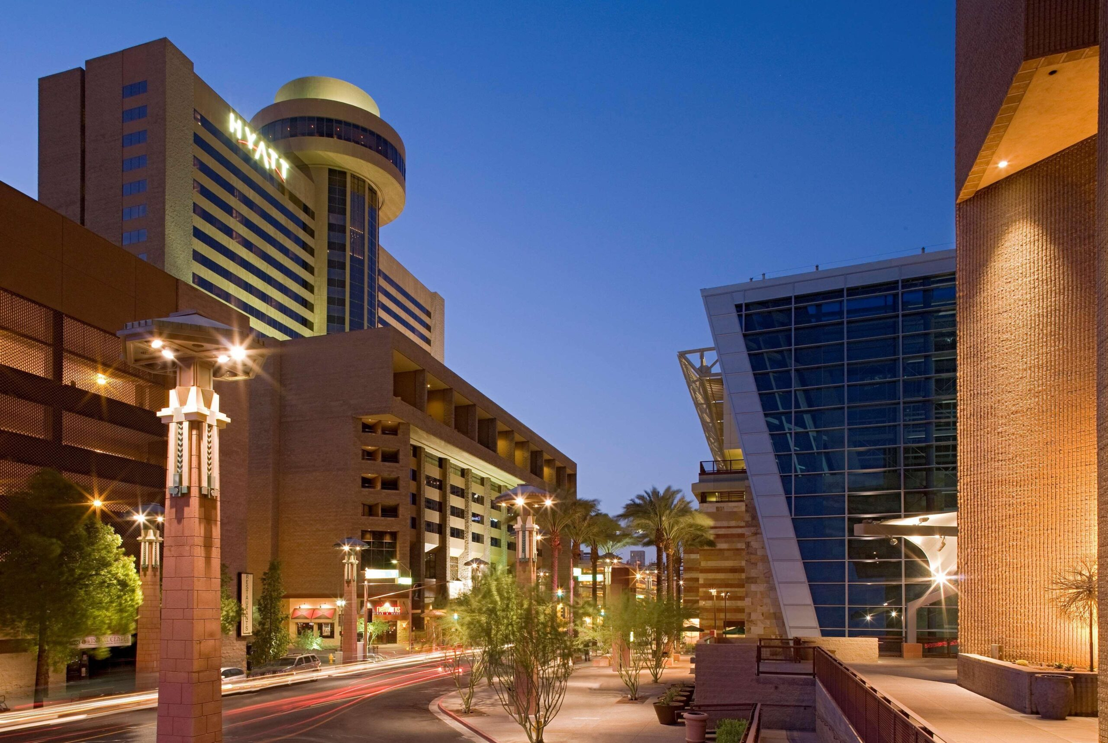
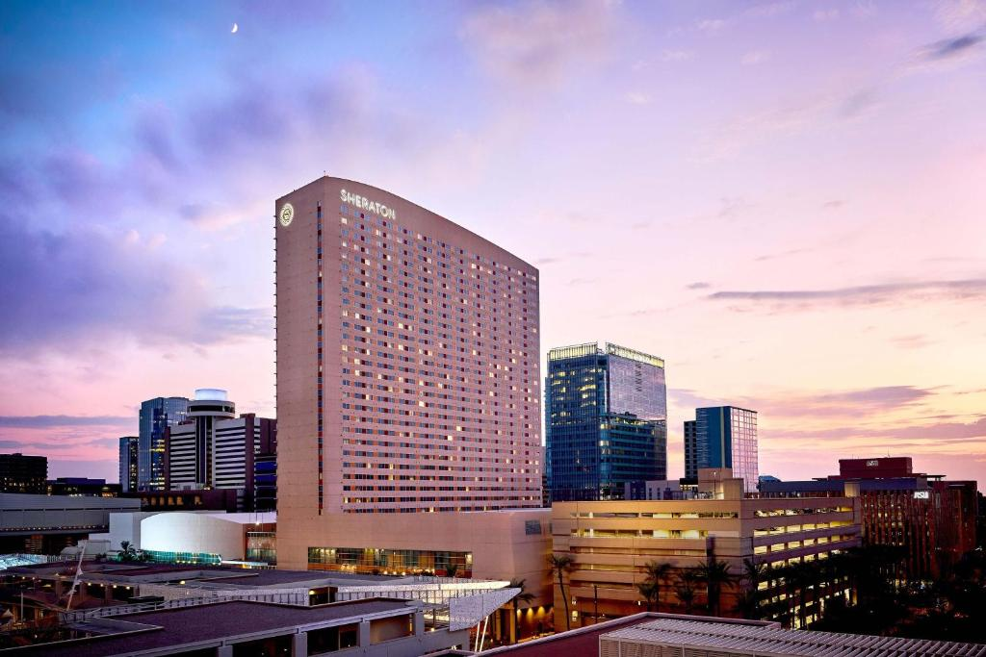
HOUSING INFORMATION
Hyatt Regency Phoenix
122 N. 2nd Street Phoenix, AZ, 85004
Rate: $269/night + tax
Sheraton Phoenix Downtown
340 N. 3rd Street Phoenix, AZ, 85004
Rate: $274/night + tax

Slide 9
HOUSING INFORMATION (cont.)
Link to book hotel available in registration confirmation email
Fly into Phoenix Sky Harbor International Airport
Deadline to secure NAWLA group rate is Monday, October 21st.
Hotel Cancellation Policy
All reservations guaranteed with deposit of one night’s room + tax
Refund provided if given notice of cancellation (48) hours prior to arrival

Slide 10
SECURITY TIPS
Take the following precautions:
Obtain insurance
Don’t mark contents on the crates
Do not store products in “EMPTY CARTONS”
Ship products in locked cages/trunks
Make a list of all products shipped
Mount/attach products to display when possible
Secure staff’s personal property

Slide 11
SECURITY TIPS (cont.)
Take the following precautions:
Stay with your products on closing day until packed and marked for shipment
Inform booth members of rules regarding removal of merchandise
Do not sell, give away, or trade merchandise
Don’t wait until end of show to report damage or theft
Contact security and/or show management immediately

Slide 12
BOOTH PACKAGE DETAILS
Each 10x10 booth will be set with –
8’ high black back drape
3’ high black side drape on each side
(1) 6’L x 30”H black draped table
(2) chairs
(1) wastebasket
The exhibit hall is NOT carpeted. All exhibitors must have flooring to cover the entirety of their booths.

Slide 13
SHIPPING DETAILS
Warehouse Shipping Address
From October 14-November 5
After the November 5 deadline, shipments received will incur an additional fee with Freeman
Exhibiting Company Name / Booth Number North American Wholesale Lumber Association- Traders Market 2024 C/O Crane / Freeman 2800 S Gilbert Rd, Ste 103 Chandler, AZ 85286 USA
Show Site Shipping Address
November 12-Show time
Exhibiting Company Name / Booth Number North American Wholesale Lumber Association- Traders Market 2024 Phoenix Convention Center C/O Freeman 100 N 3rd St Phoenix, AZ 85004 USA

Slide 14
IMPORTANT DEADLINES
Registration – All members can register until November 13 (first day of Traders Market)
If not a NAWLA member, must apply for membership by September 11
Housing – October 21, 2024 (for group rate)
Shipping Deadline
Advanced Warehouse – October 14-November 5
Direct to Convention Center – starts November 12
AV – October 25, 2024
Catering – October 29, 2024
Electrical – October 28, 2024
Internet – October 29, 2024

Slide 15
HOW TO ACCESS THE EXHIBITOR SERVICES KIT
Service Kit Link - https://www.freemanco.com/store/show/landing?nav=02&showID=530307&review=true
Login – create an account or login using your information to place orders.
Your primary contact will be able to access

Slide 16
Questions?

Slide 17
Contact Us!
Kelsey Kwasniak
Exhibits & Sponsorship Manager
Phone: (312)-673-5387
Email: kkwasniak@nawla.org
Kendall Reynolds
Exhibits & Sponsorship Coordinator
Phone: (312)-673-4723
Email: kreynolds@nawla.org or exhibits@nawla.org

